Slide 1

INDUS
THREADS
Where Indian Heritage Meets Morden Style.

Slide 2
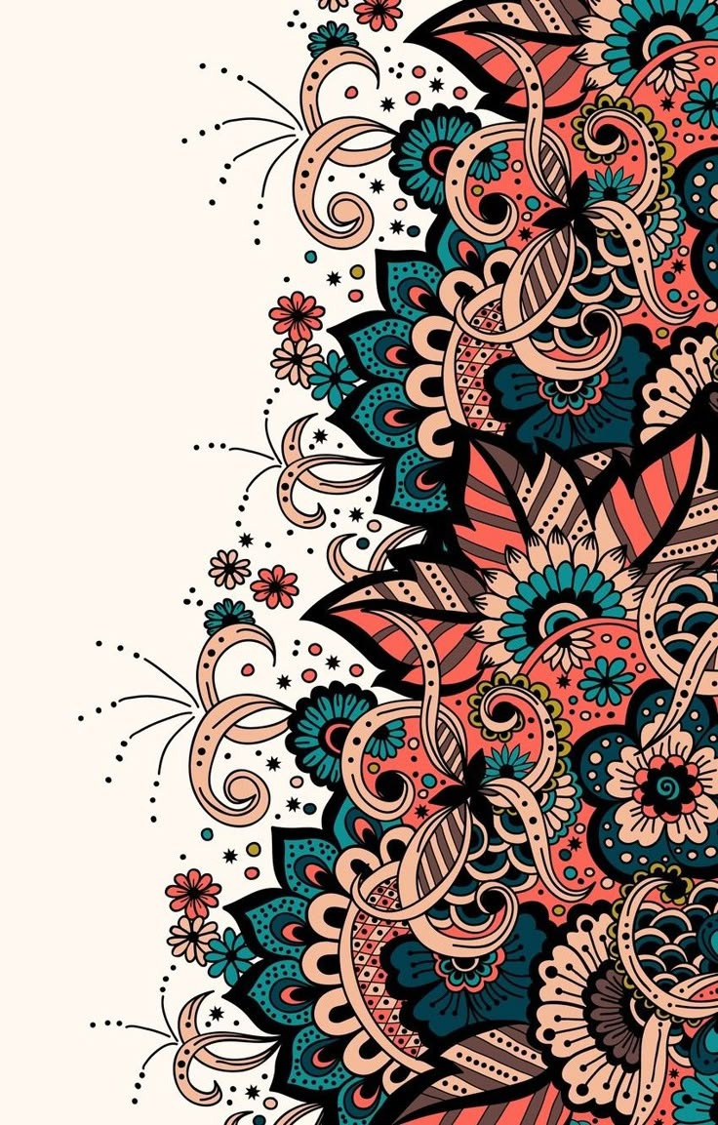
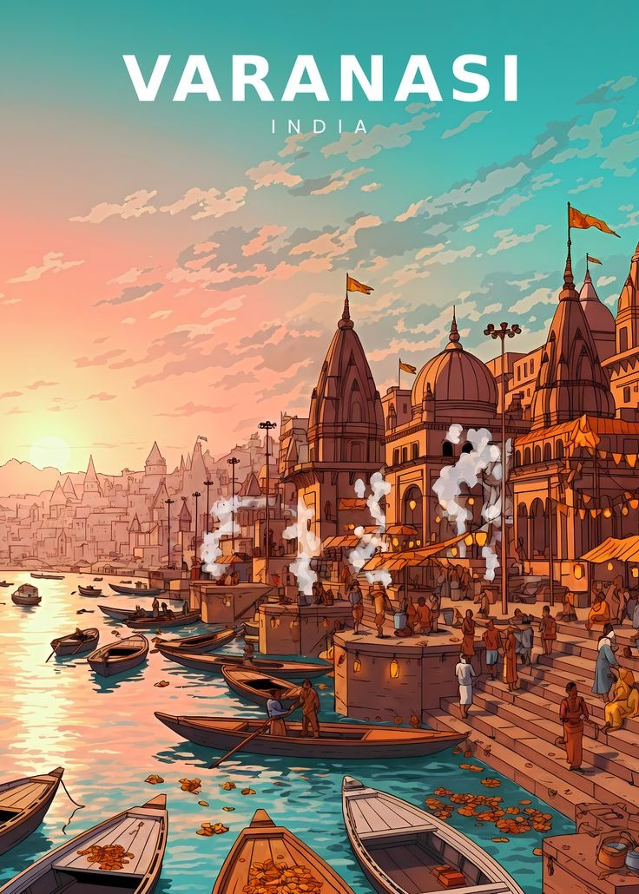
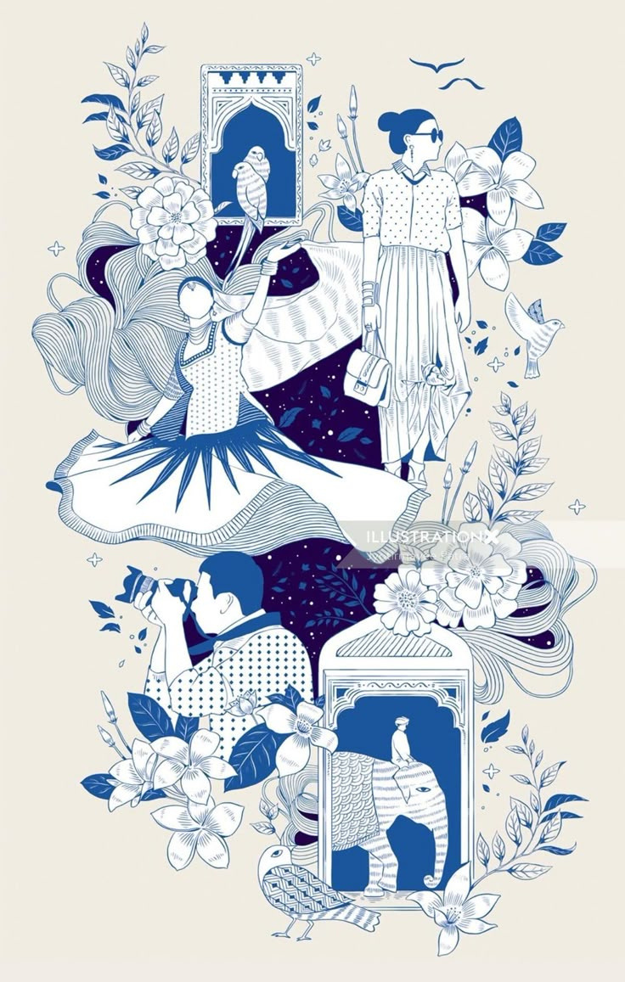
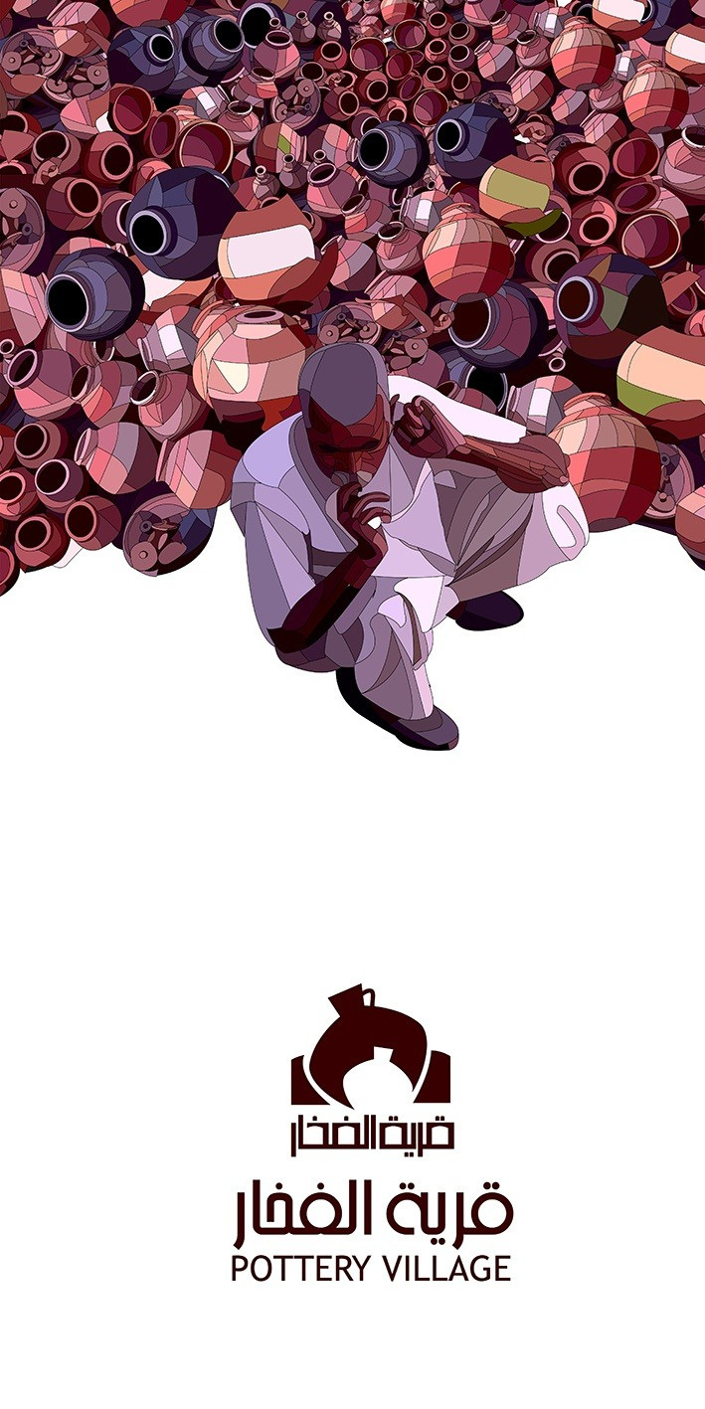
Brand Introduction
About The Brand
Indus Threads is a modern fashion label that brings together the richness of Indian heritage and today’s style — without making it expensive. We create pieces that look premium, feel comfortable, and stay within reach. For us, it’s not just about clothes — it’s about wearing culture with confidence, in a way that feels effortless and real.

Slide 3

Vision & Mission
Our Vision
To make Indian-inspired fashion modern, global, and accessible to everyone.
Our Mission
To create premium-looking, culturally rich clothing that stays affordable and wearable for everyday life.

Slide 4


Fabric & Quality
High-grade sustainable fabrics
Premium Craftsmanship
Ethical sourcing
Our products are crafted from high-grade sustainable fabrics, ensuring ethical sourcing and precision tailoring. We maintain quality control at every stage, resulting in designs that prioritize durability and comfort.
Precision tailoring
Quality control at every stage

Slide 5
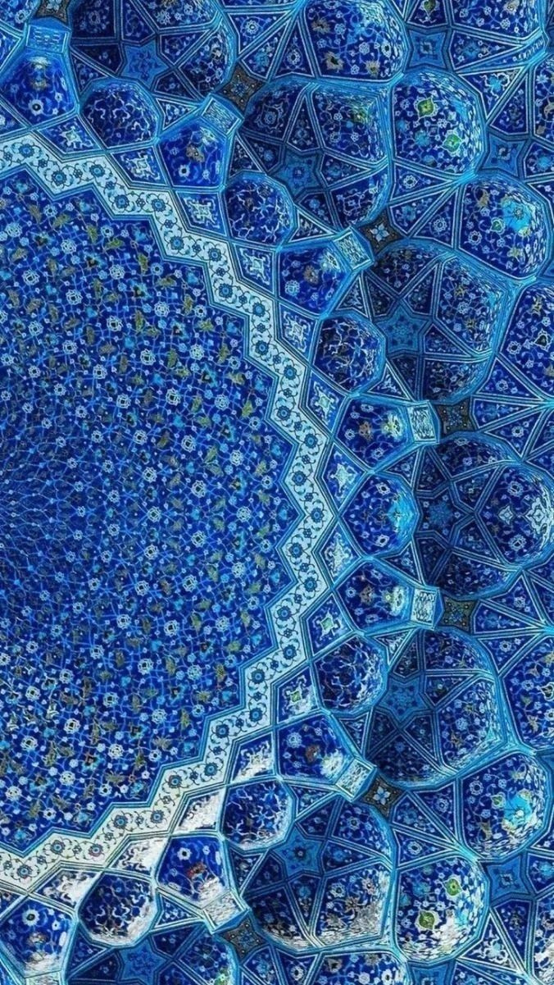
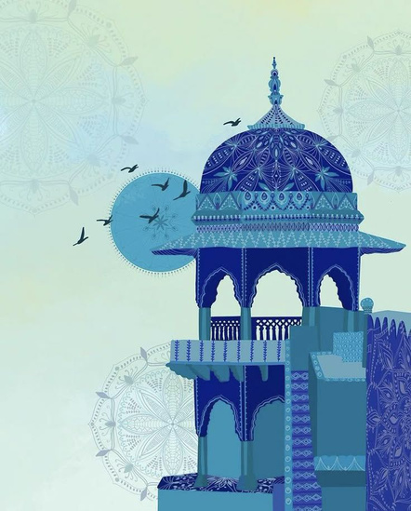
Printing Quality
Vibrant
Superior Durability
Direct to film(DTF)
Direct to Film (DTF) printing is a highly versatile method that transfers digital designs onto fabric. It is celebrated for producing vibrant, durable prints on almost any material.
Broad Fabric Compatibility
Cost-Effective

Slide 6
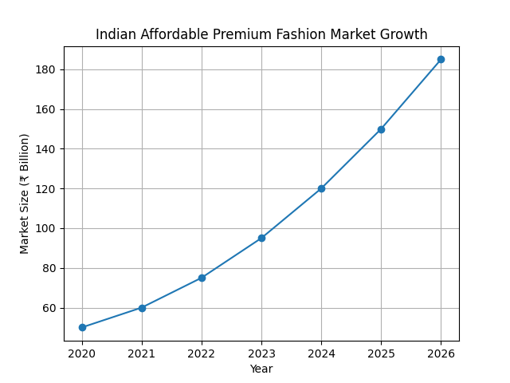
Market Opportunity
The Fashion Industry Landscape
The Indian fashion market — especially the affordable premium segment — is growing rapidly as young consumers want luxury feel without luxury pricing. This creates a strong gap that Indus Threads is perfectly positioned to capture.

Slide 7
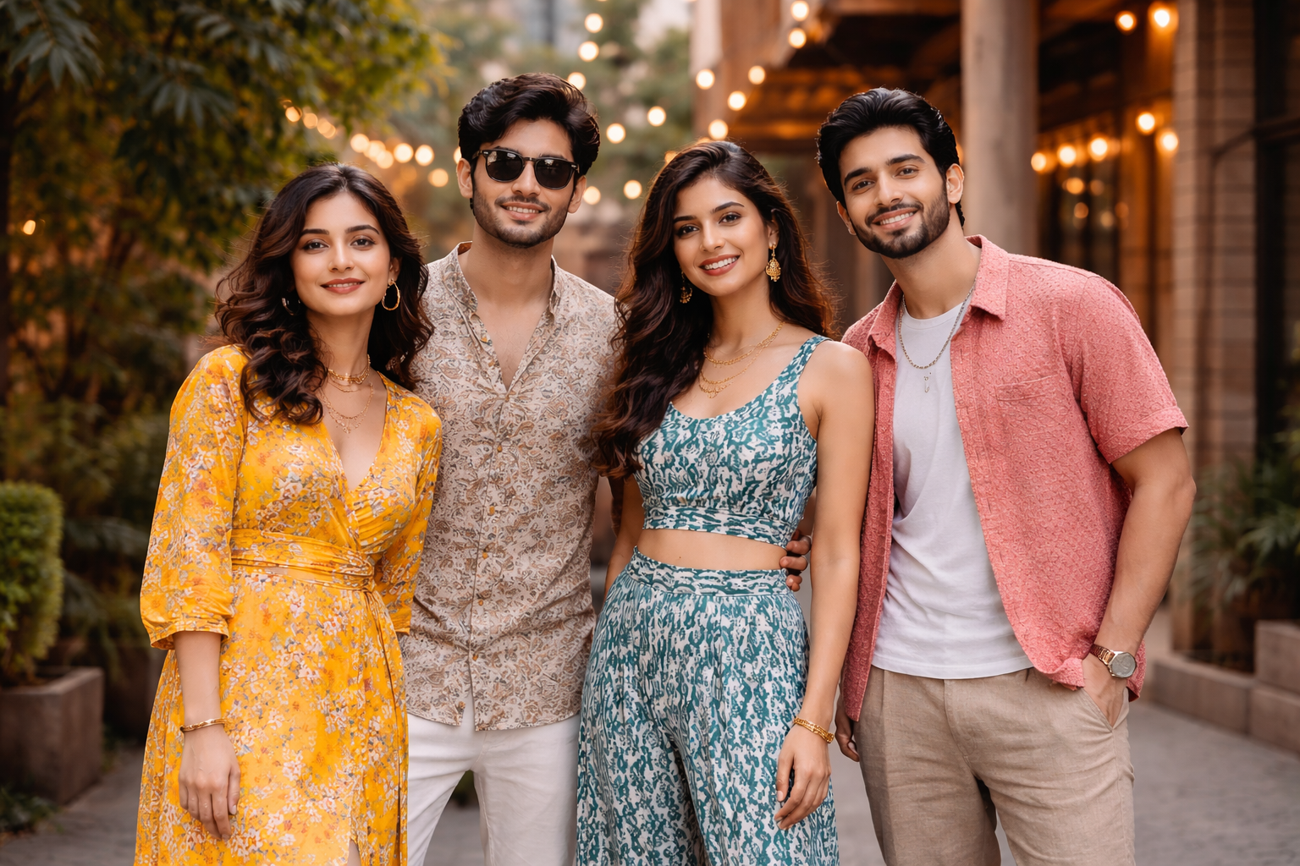

Our target audience is young, style-conscious individuals who appreciate Indian culture but prefer a modern, effortless look. They seek clothing that feels premium and expressive, yet remains affordable — allowing them to showcase their identity with confidence every day.
Target Audience
Who We Design For

Slide 8

$ Pricing Strategy
Accessible Affordable Positioning
Indus Threads follows an affordable premium pricing strategy — offering high-end aesthetics and quality at accessible price points. By positioning between streetwear and luxury, the brand delivers strong value, making customers feel they’re getting more than what they pay for.

Slide 9
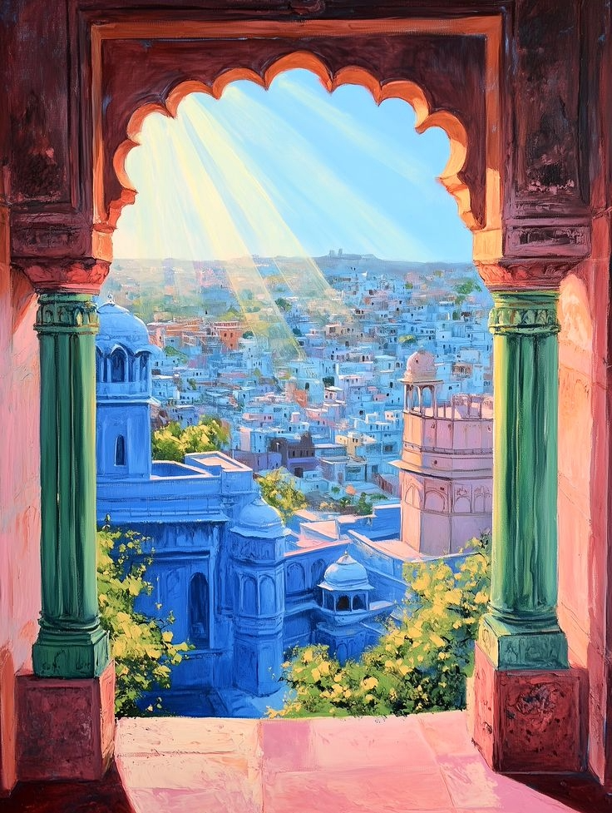
The New Collection
Bold. Refined. Effortless.
This collection represents:
Heritage (Virasat)
Identity (Pehchaan)
. Expression (Abhivyakti)
. Modern Fusion (Nayi Soch)

Slide 10
THANK YOU
Indus Threads — where tradition isn’t worn, it’s lived.

